Slide 1
Portfolio Presentation
Lexus Macalalad

Slide 2
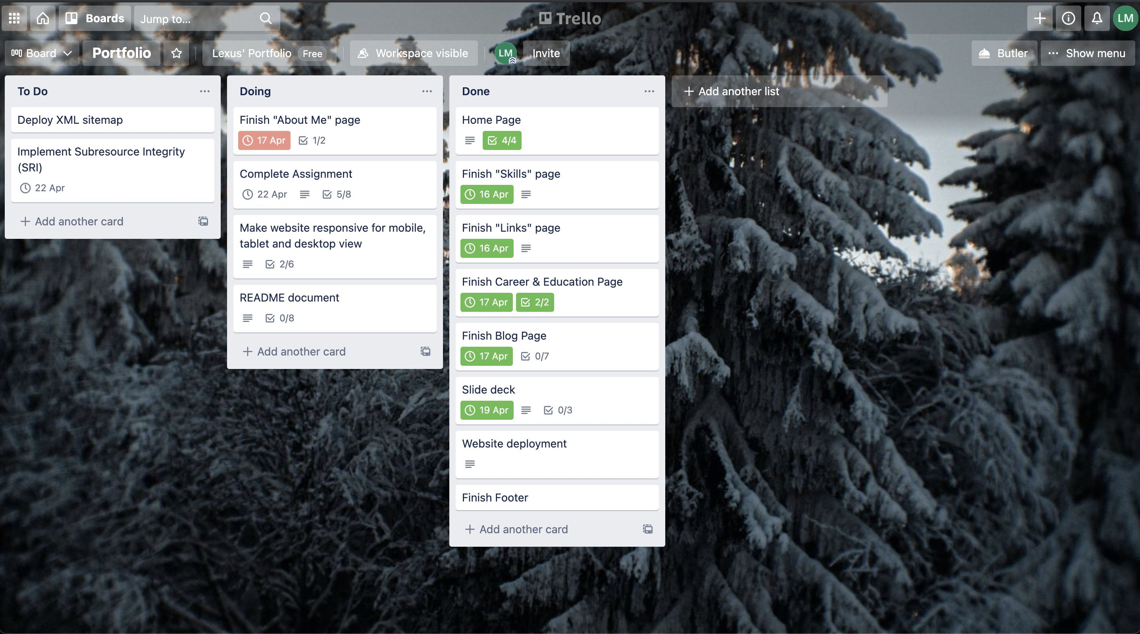
Keeping Track of Progress

Slide 3

Design Process
Sitemaps
Colour Palette
Wireframes

Slide 4
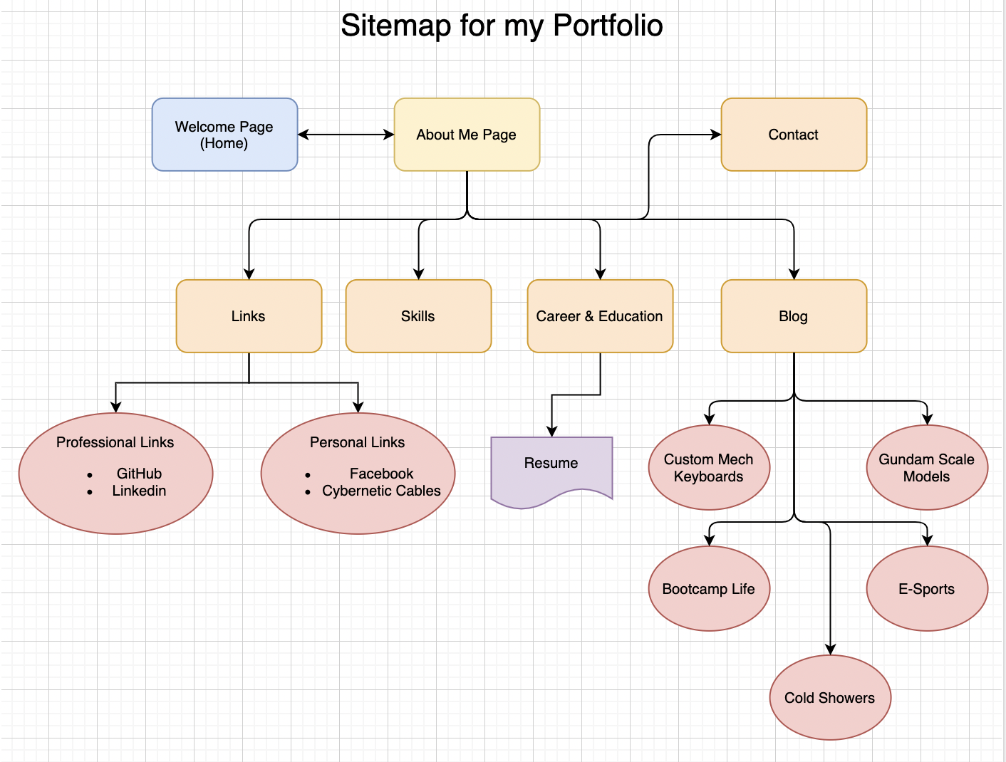
Sitemap

Slide 5
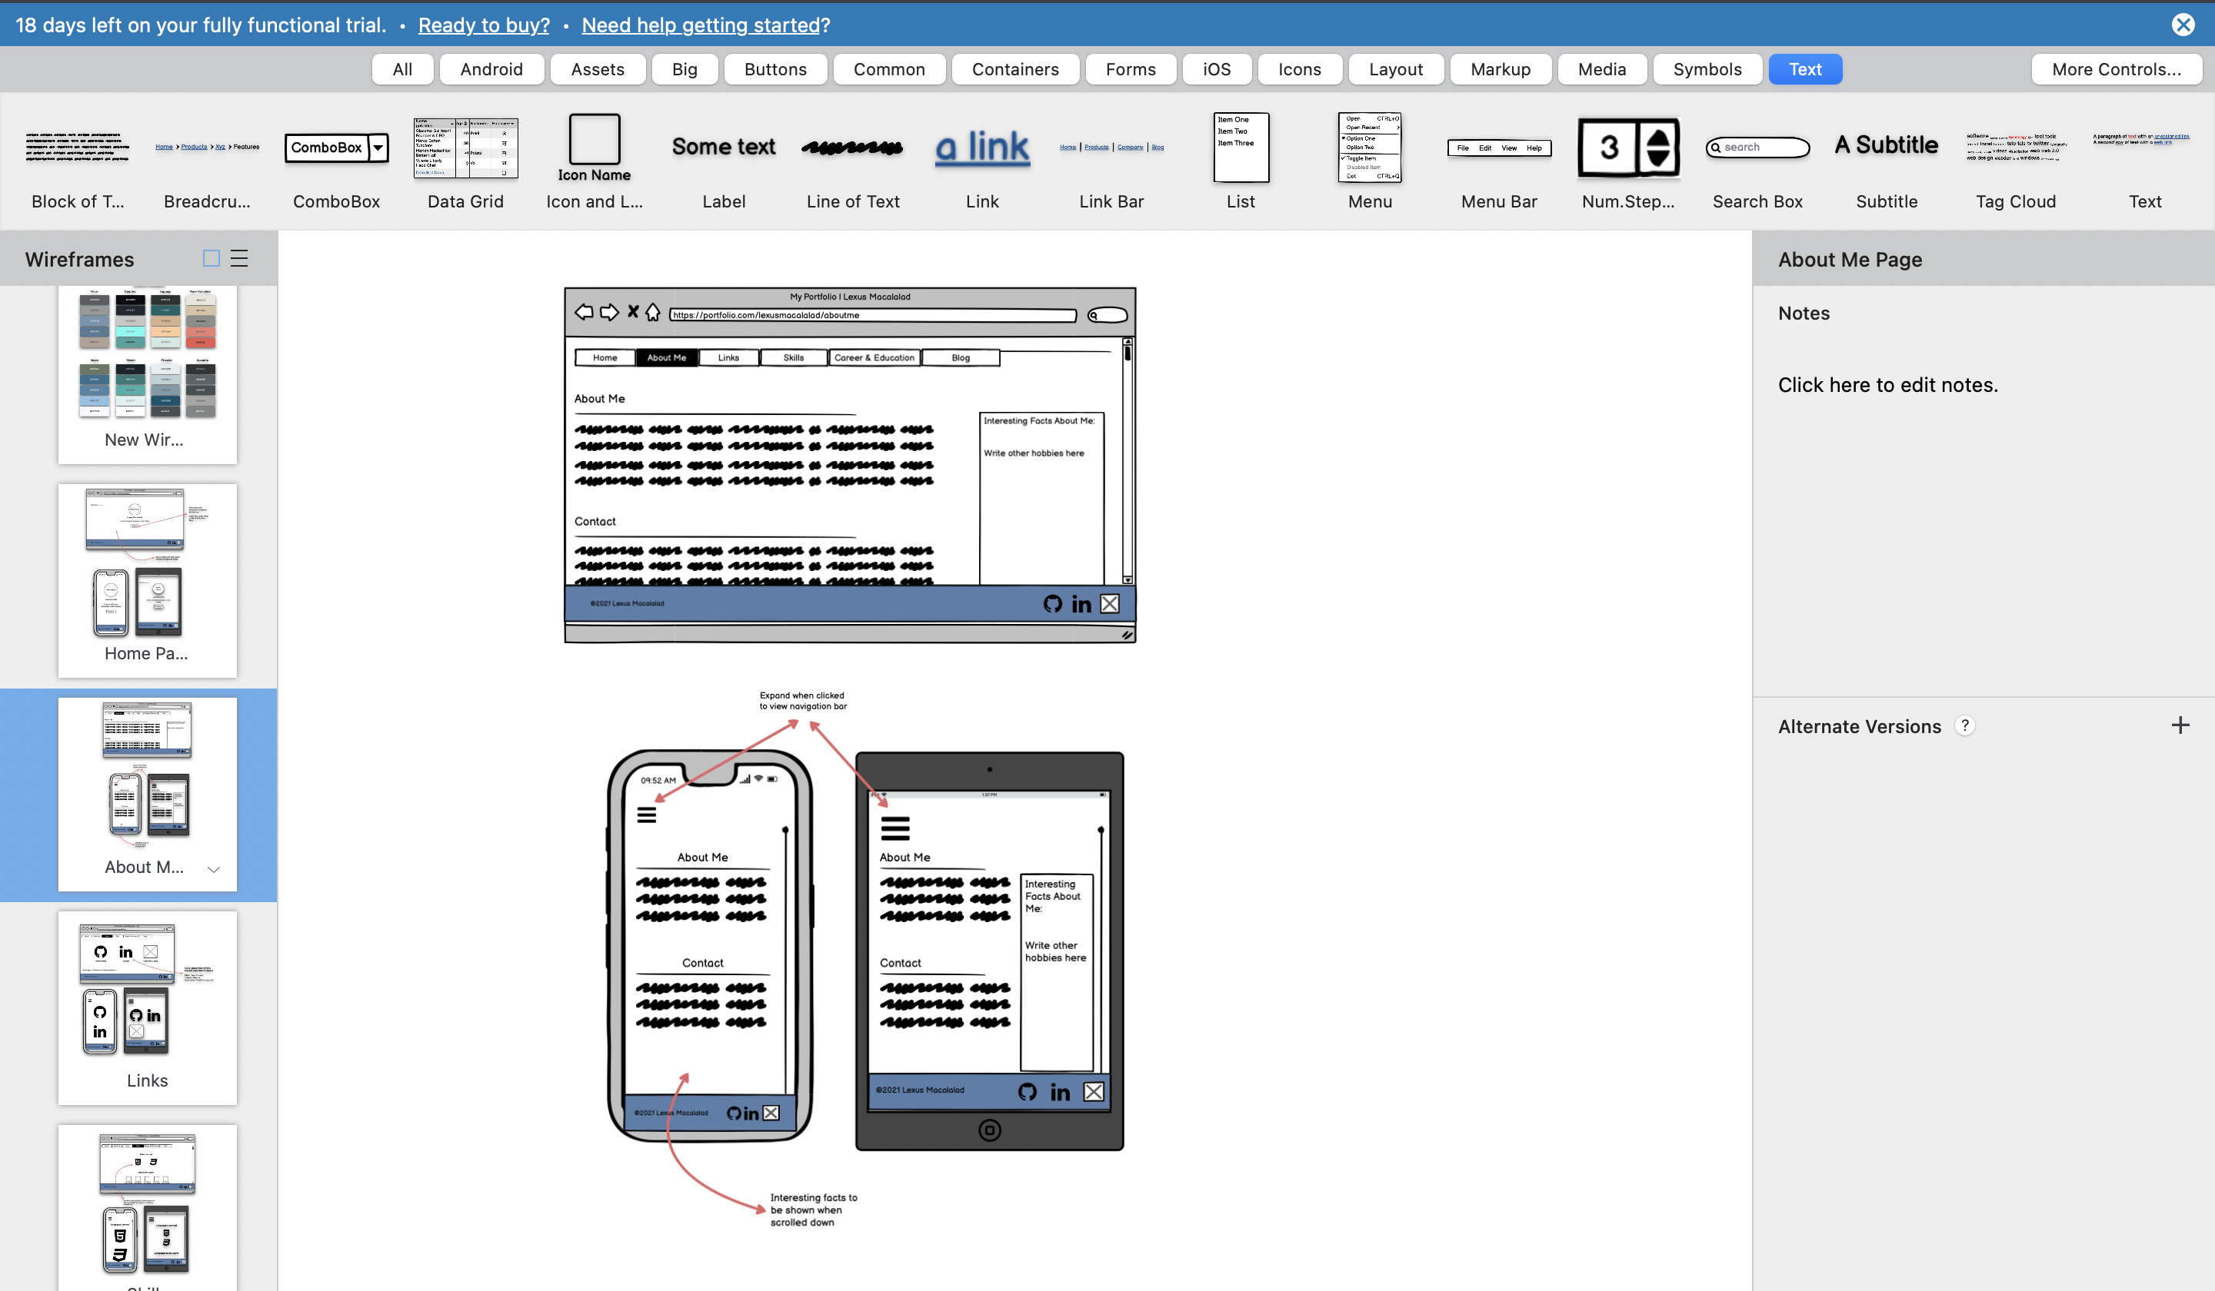
Wireframes

Slide 6
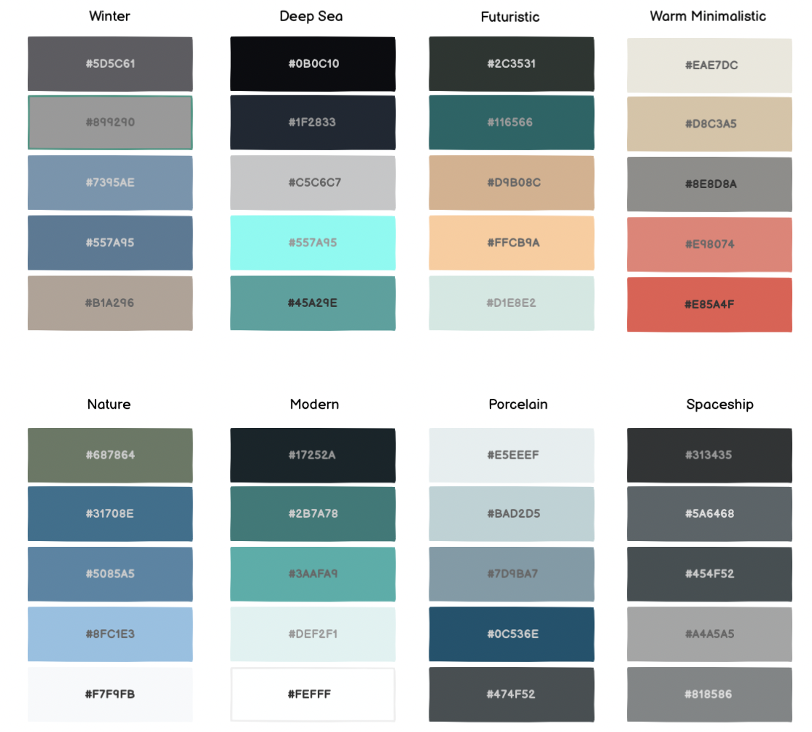
Colour Palettes

Slide 7
Component List
Navbar allows the target audience to navigate main pages without scrolling through one single page
Footer links my important social profiles
Buttons to make the website more interactive
Hover
Transitions
Colour changes

Slide 8
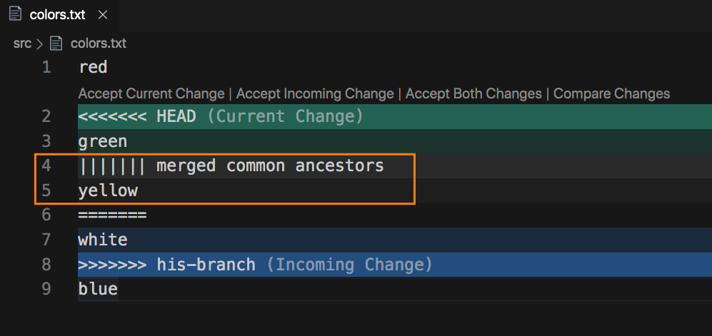
Challenges/Roadblocks
Git Conflicts
Element positioning
Margins
Flexbox

Slide 9
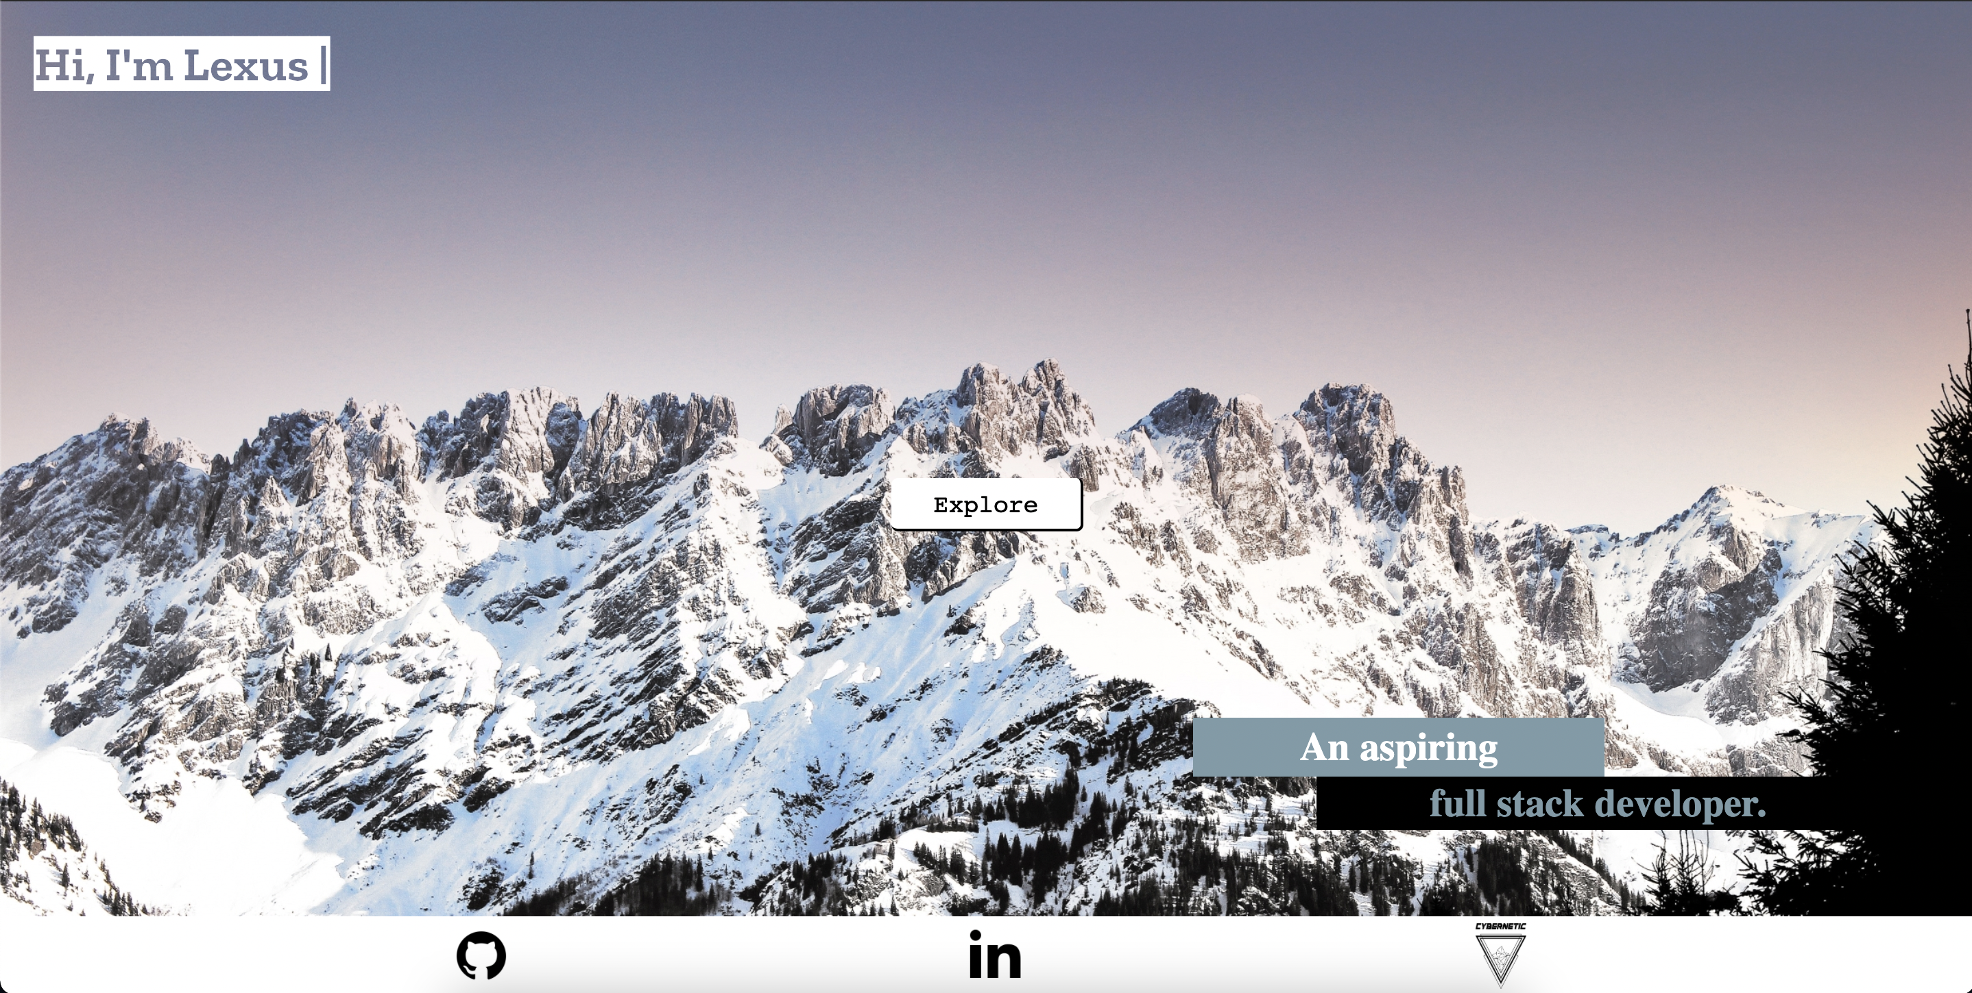

Favourite Parts
Getting the code to work
Learning process

Slide 10
Reflections
Skill level
Growth Mindset
Research or review before you start trying new things
Don’t be afraid to ask for help
Portfolio v2

